Slide 1
INTELLIGENT TRAFFIC PERCEPTION
Group: Phool Power
Team Members: - Saatvik Pareek
- Bhumika Gupta
- Aarya Agarwal

Slide 2
PROBLEM STATEMENT
With growing urban populations and congested roads, real-time traffic monitoring is essential for road safety and efficiency. Many existing systems either detect a single object category (e.g., only vehicles) or rely on outdated sensor technology. Your task is to develop a deep learning model that processes traffic video in real time, identifying multiple classes (vehicles, pedestrians, traffic signs, lanes, etc.), outputting structured data to help city planners, law enforcement, or autonomous vehicles.

Slide 3
BRIEF SOLUTION
Concept Illustration; Taken from YOLO3D GitHub repository
Real-Time Traffic Detection – YOLOv8 + ZoeDepth detects vehicles, pedestrians, traffic signs with depth from CCTVs and dashcams.
Structured Data Output – Provides bounding boxes, labels, and confidence scores in MongoDB.
3D Simulation - Creates a 3D simulation of the scene using Gazebo
Key Applications – Helps in city planning, law enforcement, and self driving vehicles.

Slide 4
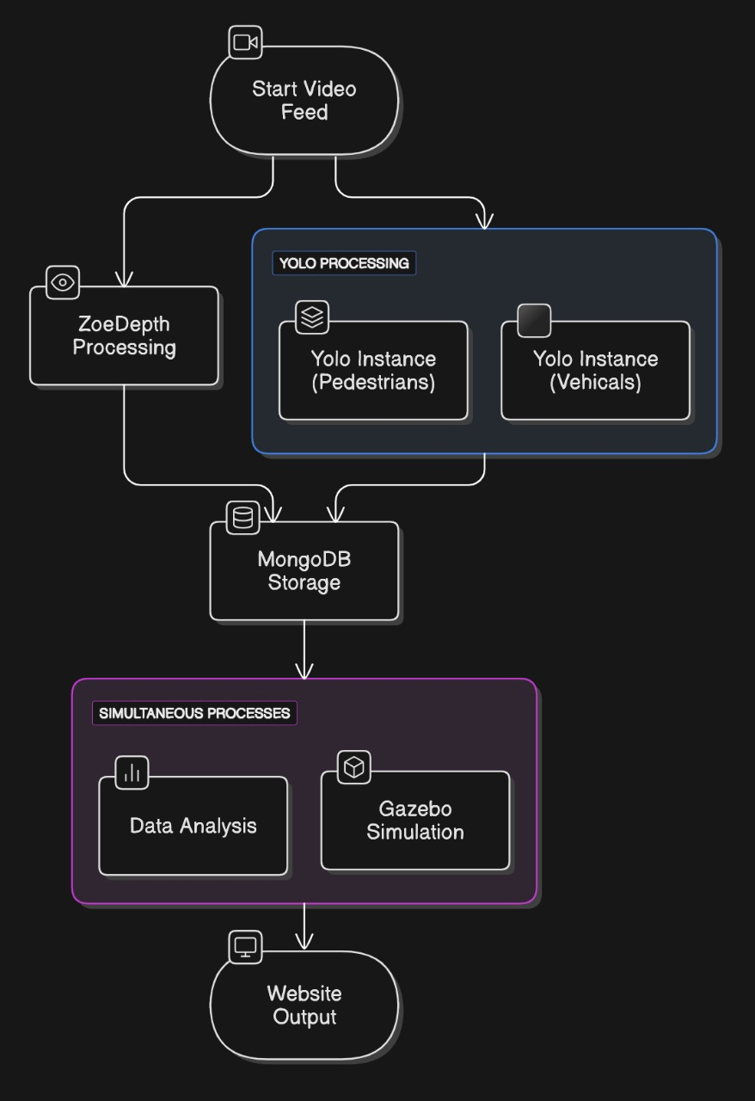
OUR APPROACH
Deploy multiple YOLO model instances for object detection.
Utilize ML-based depth estimation to extract traffic environment data. (ZoeDepth)
Store extracted data in MongoDB for modular and scalable design.
Allow analysis and reconstruction agents to access the database.
Use stored data to reconstruct a 3D traffic environment (using Gazebo).
Return data analysis and 3D environment through website

Slide 5
Advantages
Using multiple YOLO models allows us to fine tune and gain better performance on individual classes (vehicles, pedestrians, etc) without significant performance drop.
Unique to our group, we will return a 3D scene recreation using Gazebo. This has application in Self Driving.
Data will be stored in MongoDB for real time data streaming and analysis.
Heatmaps can be created using YOLO and data analysis for easy traffic analysis.

Slide 6
TECH STACK
Python (Data Analysis)
YOLOv8 / YOLO-NAS (SOTA) (Object Detection)
Depth-Anything-V2 or Zoe Depth (Monocular Depth Mapping)
Gazebo (3D simulation)
MongoDB (Database and live streaming)
Flask (Website)

